Slide 1

Citation, Referencing & Plagiarism

Slide 2
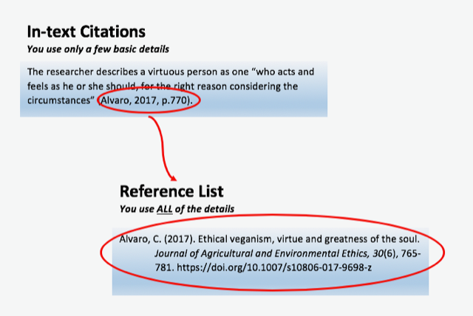
What is APA?
APA means American Psychological Association
It is a writing style guide and format used for publications in the social sciences.
Citation vs References

Slide 3
Citation/Reference
Referencing is an important academic requirement for students.
Through correct referencing, the writer acknowledges the author/s contribution to your understanding and gives the reader the opportunity to reproduce your research by following the same cited texts.
A reference list contains details of all sources cited in text.
A reference list is arranged alphabetically by author.

Slide 4
Citation/Reference
Sources with no author is cited by title, included in the alphabetical list using the first significant word of the title.
A reference list is generally placed at the end of a work
Commas are used to separate each item of the reference/citation
Electronic sources – use angle brackets (<>) to isolate the address/URL from the rest of the reference

Slide 5
Et Al
Et al (meaning “and others” – used to shorten the APA in-text citation with three or more authors only after all authors have been used before in the first citation
Only include the first author’s last name, followed by “et al.”, a comma and the year of publication
(Taylor et al., 2018).
Et al is used in academic writing to avoid unnecessary wordiness when crediting an author in-text.

Slide 6
Different types of Reference
Authored book:
Reference list: Ashbourn, J. (2014) Biometrics in the new world: the cloud, mobile technology and pervasive identity. 2nd edn. London: Springer.
In-text citation: (Ashbourn, 2014)
Edited book:
Reference list: Nasta, S. and Stein, M.U. (eds) (2020) The Cambridge history of Black and Asian British writing. Cambridge: Cambridge University Press.
In-text citation: (Nasta and Stein, 2020)
E-book:
Where an e-book looks like a printed book (usually PDFs) with publication information and page numbers - cite it in the same way as a printed book (above).
In-text citation: (Prior, 2020, 74%)
Reference list: Faulkner, W. (2000) Light in August. Available at: https://www.vlebooks.com/vleweb/product/openreader?id=UniReading&isbn=9781446485521 (Accessed: 10 September 2021).
In-text citation: (Faulkner, 2000, ch. 7, p. 105)
Reference list: Prior, H. (2020) Away with the penguins. Available at: https://www.amazon.co.uk/Away-Penguins-Hazel-Prior-ebook (Accessed: 20 September 2021).

Slide 7
EXAMPLES
Number of authors | First text citation (either parenthetical or narrative) | Subsequent text citations (all)
One or two | Palmer & Roy, 2008 | Palmer & Roy, 2008
Three, four, or five | Sharp, Aarons, Wittenberg, & Gittens, 2007 | Sharp et al., 2007
Six or more | Mendelsohn et al., 2010 | Mendelsohn et al., 2010

Slide 8
UNKNOWN AUTHOR
If the work does not have an author,
Example:
Where "Anonymous" is used for the author’
Cite the source by its title.
Titles of books and reports are italicized; titles of articles, chapters, and web pages are in quotation marks. APA style calls for capitalizing important words in titles when they are written in the text (but not when they are written in reference lists).
treat it as the author's name (Anonymous, 2001). In the reference list, use the name Anonymous as the author.
A similar study was done of students learning to format research papers ("Using Citations," 2001).

Slide 9
Organization as an AUTHOR
If the author is an organization or a government agency
Example:
According to the American Psychological Association (2000),...
Mention the organization in the signal phrase or in the parenthetical citation the first time you cite the source, just as you would an individual person if the work does not have an author,
If the organization has a well-known abbreviation:
Second citation: (MADD, 2000)
Include the abbreviation in brackets the first time the source is cited and then use only the abbreviation in later citations.
Example:
First citation: (Mothers Against Drunk Driving [MADD], 2000)

Slide 10
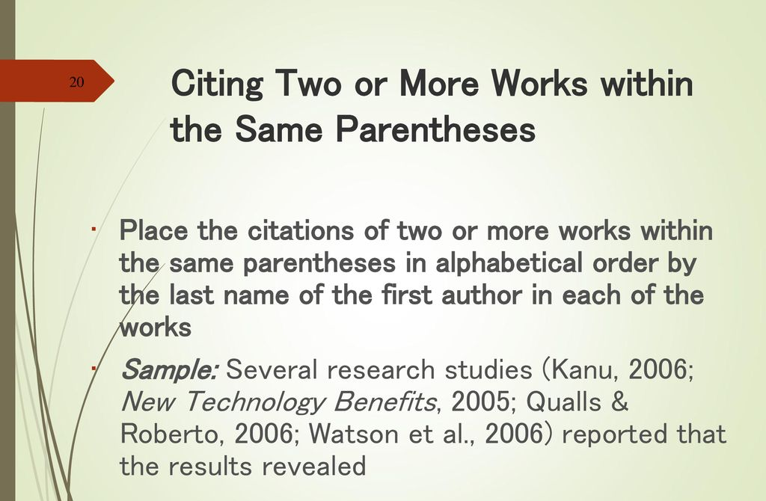
TWO OR MORE WORKS IN THE SAME PARENTHESES
When your parenthetical citation includes two or more works, order them the same way they appear in the reference list (viz., alphabetically), separated by a semi-colon.
(Berndt, 2002; Harlow, 1983)

Slide 11
Personal Communication
For interviews, letters, e-mails, and other person-to-person communication:
cite the communicator's name, the fact that it was personal communication, and the date of the communication. Do not include personal communication in the reference list.
E.g.
(E. Robbins, personal communication, January 4, 2001).

Slide 12
WEBPAGE OR PIECE OF ONLINE CONTENT
If the page names an individual author, cite their name first:
If the resource was written by a group or organization, use the name of the group/organization as the author. Additionally, if the author and site name are the same, omit the site name from the citation.
Price, D. (2018, March 23). Laziness does not exist. Medium. https://humanparts.medium.com/laziness-does-not-exist-3af27e312d01
Lastname, F. M. (Year, Month Date). Title of page. Site name. URL
Group name. (Year, Month Date). Title of page. Site name. URL
American Society for the Prevention of Cruelty to Animals. (2019, November 21). Justice served: Case closed for over 40 dogfighting victims. https://www.aspca.org/news/justice-served-case-closed-over-40-dogfighting-victims

Slide 13
WEBPAGE OR PIECE OF ONLINE CONTENT
If the page's author is not listed, start with the title instead. Additionally, include a retrieval date when the page's content is likely to change over time (like, for instance, if you're citing a wiki that is publicly edited).
Title of page. (Year, Month Date). Site name. Retrieved Month Date, Year, from URL
Tuscan white bean pasta. (2018, February 25). Budgetbytes. Retrieved March 18, 2020, from https://www.budgetbytes.com/tuscan-white-bean-pasta/
If the date of publication is not listed, use the abbreviation (n.d.).
Author or Group name. (n.d.). Title of page. Site name (if applicable). URL
National Alliance on Mental Illness. (n.d.). Mental health conditions. https://www.nami.org/Learn-More/Mental-Health-Conditions

Slide 14

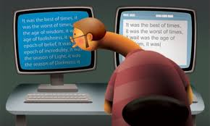
Plagiarism
Presentation of the work from another source as your own.
Incorporation into your work without acknowledgement of the source.
This includes published as well as material generated through artificial intelligence.
It applies not only to text but media, illustrations, graphs, etc.
Types of Plagiarism
Verbatim - word for word quotations from a source
Internet sources – cutting and pasting without citations
Paraphrasing
Collusion – unauthorized collaboration between students
Inaccurate citations

Slide 15
Examples

Slide 16
Examples: In-text Direct quotes & indirect mention
Direct quote with brief citation:
Wenger (1998, p.181) argues that; "Engagement, imagination and alignment each create relations of belonging".
Indirect mention with brief citation in Harvard style:
Theorists have considered the impact of a variety of circumstances on the creation and expansion of identity (Wenger, 1998; Lee, 2013; Morton and Grainger, 2009).

Slide 17
Long Quotes
Long quotes are used in assignments requiring analysis and require reference to a large number of phrases within the text and some more than once.
Long quotes should only be used if you are planning to analyse the text in some detail.
For example:
While students may feel that referencing is outdated, others have a different understanding:
Is an insistence on referencing about supporting a system and a process of learning that is a legacy of a different time and society? Are universities enforcing upon you an arcane practice of referencing that you will probably never use again outside higher education? Or is there something deeper in the practice of referencing that connects with behaving ethically, properly, decently and respecting others - ageless societal values that universities should try to maintain?
Neville, 2007, pp.27-8.

Slide 18
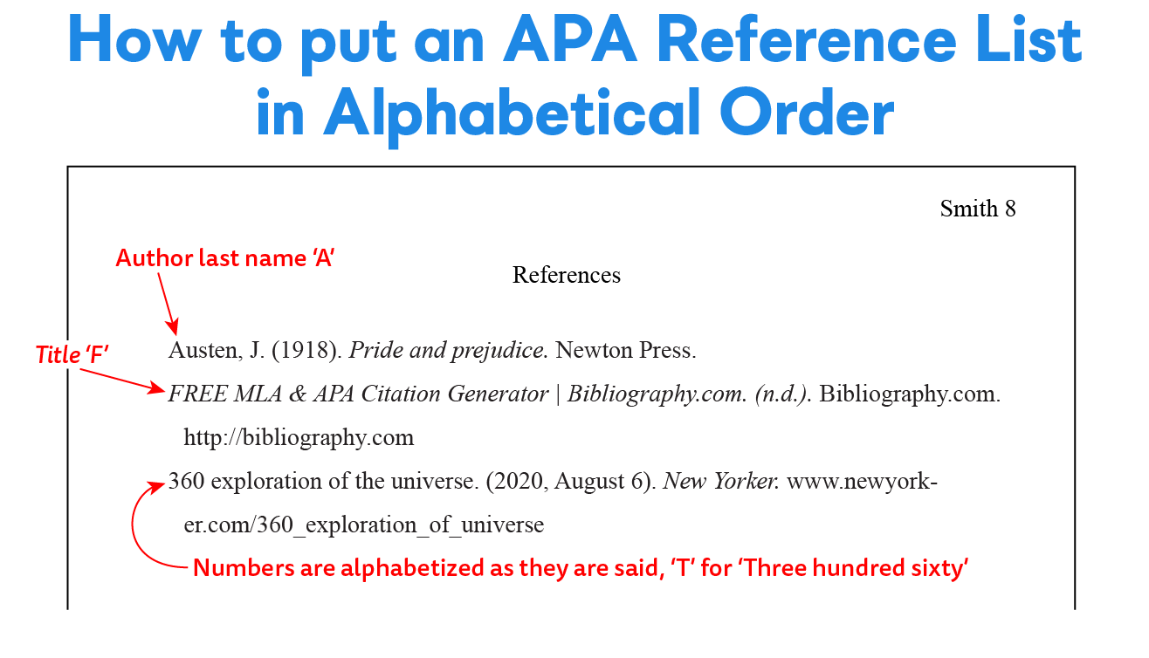

Slide 19
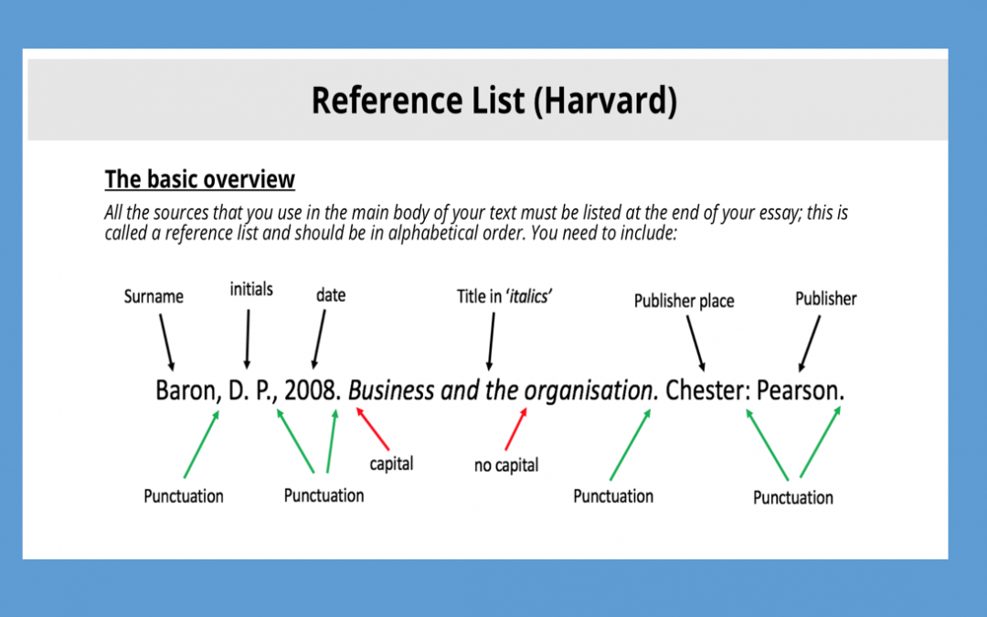
Referencing: Book

Slide 20
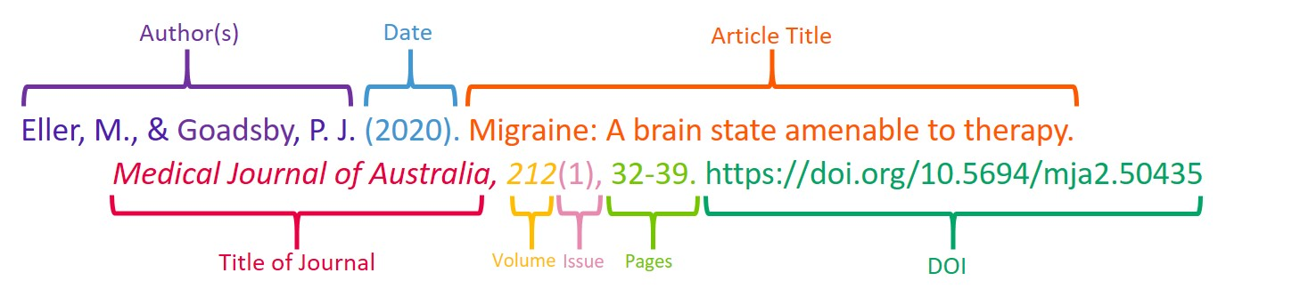
Referencing: Journal Article

Slide 21
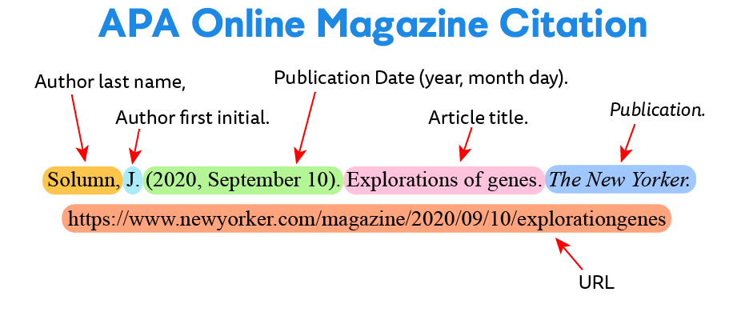

Slide 22
References
Albanese, A (Minister for Infrastructure, Transport, Regional Development and Local Government) 2009, Fairer compensation for air travellers, media release, 29 January, Department of Infrastructure, Transport, Regional Development and Local Government, Canberra, viewed 30 January 2009, <http://www.minister.infrastructure.gov.au/releases/2009>.
Australian Government Publishing Service 1987, Commonwealth printing and publishing manual, 2nd edn, A.G.P.S., Canberra.
Australian Institute of Health and Welfare 2010, Child protection Australia 2008-09, Child welfare series no. 47. Cat. no. CWS 35, Australian Institute of Health and Welfare, Canberra, viewed 06 November 2012, <https://www.aihw.gov.au/reports/child-protection/child-protection-australia-2008-09/contents/table-of-contents>.
Be, know, do: leadership the Army way 2004, Jossey-Bass, San Francisco.
Berkman, RI 1994, Find It fast: how to uncover expert information on any subject, HarperPerennial, New York.
Bernstein, D 1995, ‘Transportation planning’, in WF Chen (ed.), The civil engineering handbook, CRC Press, Boca Raton, pp. 231-61.
Bhattacharjee, M 1998, Notes of infinite permutation groups, Lecture notes in mathematics no.1698, Springer, New York.
Bourassa, S 1999, ‘Effects of child care on young children’, Proceedings of the third annual meeting of the International Society for Child Psychology, International Society for Child Psychology, Atlanta, Georgia, pp. 44-6.
Bowden, FJ & Fairley, CK 1996, ‘Endemic STDs in the Northern Territory: estimations of effective rates of partner change’, paper presented to the scientific meeting of the Royal Australian College of Physicians, Darwin, 24-25 June.

Slide 23
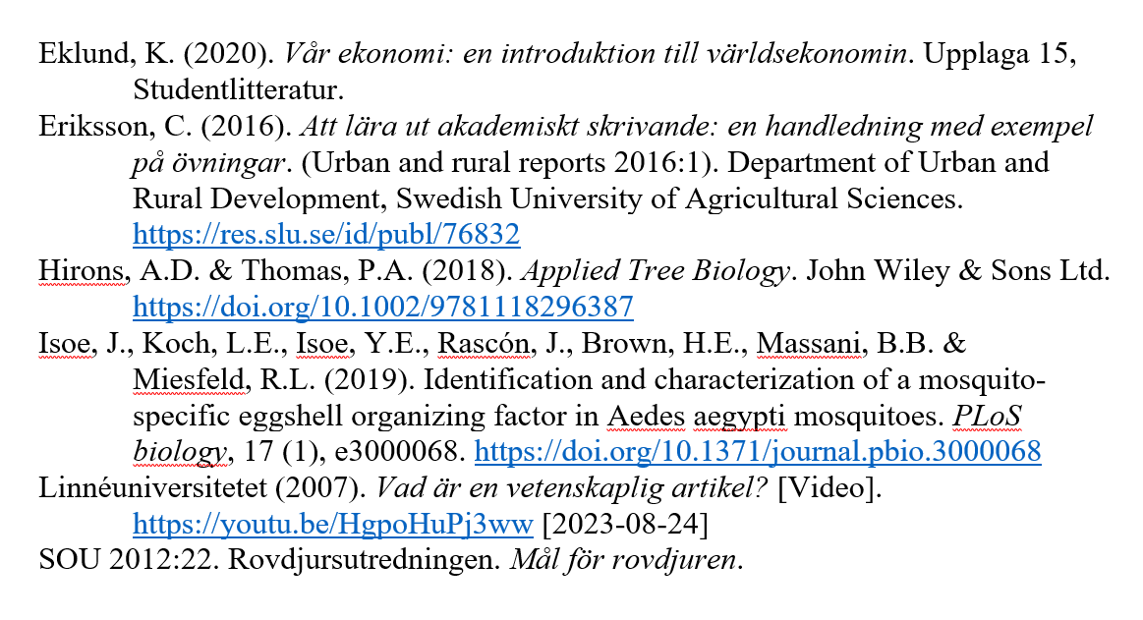

Slide 24
Research Essay Assignment
Review notes on the research essay requirements
Select a topic that seeks to explain, compare, or decipher an occurrence
Brainstorm a few major questions to research the topic
Select 5 sources from which to gather notes on your topic.
Write the source notes
Make outline and write up your research paper.
Choose a topic of interest
Write a reason or purpose for choosing your topic.
Make notes for each major question of your topic.

Slide 25

Checklist
I have followed all instructions in the assignment sheet.
My introduction presents my topic in an engaging way and provides necessary background information.
My introduction presents a clear, focused research problem and/or thesis statement.
My paper is logically organized using paragraphs and (if relevant) section headings.
Each paragraph is clearly focused on one central idea, expressed in a clear topic sentence.
Each paragraph is relevant to my research problem or thesis statement
I have used appropriate transitions to clarify the connections between sections, paragraphs, and sentences.
My conclusion provides a concise answer to the research question or emphasizes how the thesis has been supported
My conclusion shows how my research has contributed to knowledge or understanding of my topic.
My conclusion does not present any new points or information essential to my argument.
I have provided an in-text citation every time I refer to ideas or information from a source.
I have included a reference list at the end of my paper, consistently formatted according to a specific citation style.
I have thoroughly revised my paper and addressed any feedback from my professor or supervisor.
I have followed all formatting guidelines (page numbers, headers, spacing, etc.).

